Slide 1
The LC-3 Part I
Chapter 5

Slide 2
Outline
The ISA: Overview
Memory, Registers, Instruction Set, Opcodes, Datatypes, Addressing Modes, Condition Codes
Instruction Set
Datapath, Control signals to implement each instruction
ALU, Data movement (load/store), and Control Instructions
Addressing Modes
The Microsequencer and Microcode

Slide 3
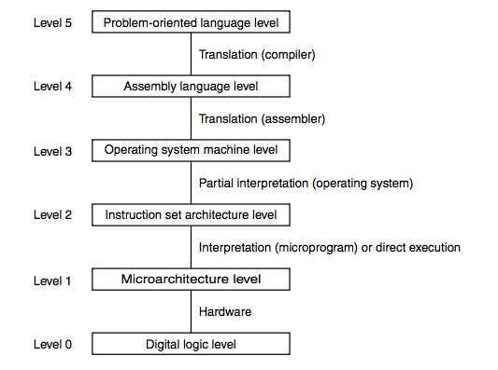
Road Map -- Where are we?
“C”
“Assembly Language”
“Machine Language”
“Microcode"
“Sequential Logic”

Slide 4
Instruction Set Architecture
The ISA specifies all the information about the computer that the software needs to be aware of.
The ISA is a programmer’s view of the CPU (e.g. LC-3) from the outside (how do I write machine code/assembly?)
The internal implementation of the LC-3 is the datapath and microcode.
Who uses an ISA?
What is specified?

Slide 5
Who uses an ISA?
Machine language programmers
Assembly language programmers
Compiler writers
High-level language programmers interested in performance, debugging, etc.

Slide 6
ISA: What Is Specified?
Memory organization
Registers
Instruction set
Opcodes
Data types
Addressing modes

Slide 7
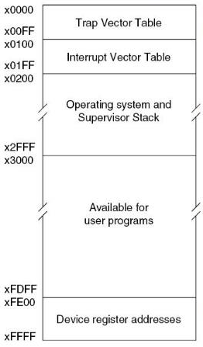
LC-3 Memory Organization
Address space
16 bit addresses
0-65535
x0-xFFFF
Addressability
16 bits
Word Addressable/Byte Addressable?
Strictly word addressable with 16 bit words.
Note these boundaries for later

Slide 8
LC-3 Registers
General Purpose Registers
Is the PC considered to be a GPR?
Question:
Yes
No
Conventions
3

Slide 9
LC-3 Registers
General Purpose Registers
8 General Purpose Registers
R0 - R7
Is the PC considered to be a GPR?
No
Conventions
Certain Registers will have designated purposes
(That comes later; for now you can use all 8 of them)

Slide 10
Question
What memory addresses are allocated to store user programs and data?
0x2000 – 0x2FFF
0x2000 – 0xFE00
0x0000 – 0xFFFF
0x3000 – 0xFDFF
10

Slide 11
LC-3 Instruction Set
Instruction
Op Code
Operands
Instruction Set
Op Codes
Operate (ALU)
Data movement (load/store memory)
Control (conditionals, loops, etc.)
Data Types
Addressing Modes

Slide 12
How Many Instructions? (ISA design philosophies)
Lots
CISC (Complex Instruction Set Computer)
Intel X86, DEC VAX, IBM Z-series
Do as much as you can in a single instruction.
Relatively easy to write efficient machine code by hand.
Few
RISC (Reduced Instruction Set Computer)
ARM, PowerPC, MIPS, LC-3
Expose as much as you can to the compiler so that it can optimize.
Hard to write efficient machine code by hand.

Slide 13
LC-3 Machine Code and Assembly Language
For now, we are focused on the LC-3 datapath
The circuit implementation, and the state machine
The control signals that make each instruction happen
You will need to understand what each LC-3 machine code instruction does – atomically, in insolation
What registers or memory locations does it change?
Which ALU operation is happening?
How does the data flow through each MUX and the bus to make the operation execute with the desired behavior?
You do NOT need to understand why or how you would use these instructions in a program yet.
We’ll cover that later, with assembly programming
For now, just understand each instruction’s behavior – so you can know how to implement it in the datapath and microcode, using control signals

Slide 14
Meet the LC-3 Instruction Set
16-bit instructions
4 bits for opcode (bits 15-12)
How many instructions?
15 – code 1101 is reserved for future use.

Slide 15
LC-3 Assembly Language
What is it?
A symbolic (text, human readable) representation of the binary machine language
Instructions are one-to-one between AL and ML
Example assembly language:
ADD R1, R2, R3

Slide 16
Categories of LC-3 Instructions
Operate (ALU)
Data Movement (Memory)
Control
ADD
AND
NOT
Load
LD
LDR
LDI
LEA
Store
ST
STR
STI
BR
JMP
JSR
JSRR
RET
RTI
TRAP

Slide 17
Operate (ALU) Instructions
Operate (ALU)
Data Movement (Memory)
Control
ADD
AND
NOT
Load
LD
LDR
LDI
LEA
Store
ST
STR
STI
BR
JMP
JSR
JSRR
RET
RTI
TRAP

Slide 18
LC-3 Instructions, first half
ADD⁺
0001
DR
SR1
0
00
SR2
ADD⁺
0001
DR
SR1
1
imm5
AND⁺
0101
DR
SR1
0
00
SR2
AND⁺
0101
DR
SR1
1
imm5
BR
0000
n
z
p
PCoffset9
JMP
1100
000
BaseR
000000
JSR
0100
1
PCoffset11
JSRR
0100
0
00
BaseR
000000
LD⁺
0010
DR
PCoffset9
LDI⁺
1010
DR
PCoffset9
⁺ Indicates instructions that modify condition codes

Slide 19
LC-3 Instructions, second half
LDR⁺
0110
DR
BaseR
offset6
LEA
1110
DR
PCoffset9
NOT⁺
1001
DR
SR
111111
RET
1100
000
111
000000
RTI
1000
000000000000
ST
0011
SR
PCoffset9
STI
1011
SR
PCoffset9
STR
0111
SR
BaseR
offset6
TRAP
1111
0000
trapvect8
reserved
1101
⁺ Indicates instructions that modify condition codes

Slide 20
Let’s Look at the NOT Instruction
NOT
The operand (SR) and the result (DR) are both stored in registers
in the register file (R0-R7)
An example NOT instruction:
NOT R3,R3 1001 011 011 111111
NOT
1001
DR
SR
111111

Slide 21
Machine Instruction Cycle
Recall our states:
Fetch 1
Fetch 2
Fetch 3
Decode
Execute
Fetch and Decode are the same for EVERY instruction.

Slide 22
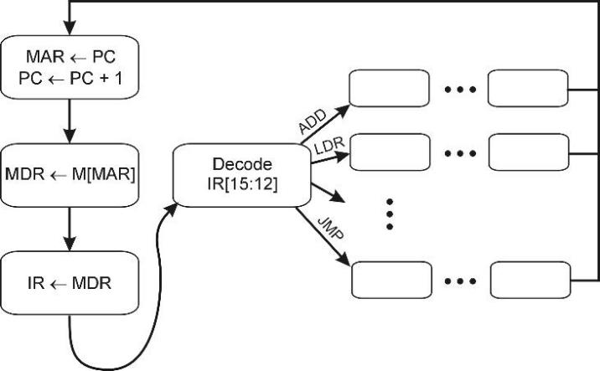
What Makes the Fetch-Execute Cycle Happen?
The FSM, which sequences through the states.
It turns on the appropriate control signals as it enters each state.
F
18
EA/OP/EX/S
1
D
6
33
32
30
12
A more complete state diagram is in Appendix C.
It will be more understandable after the rest of this deck

Slide 23
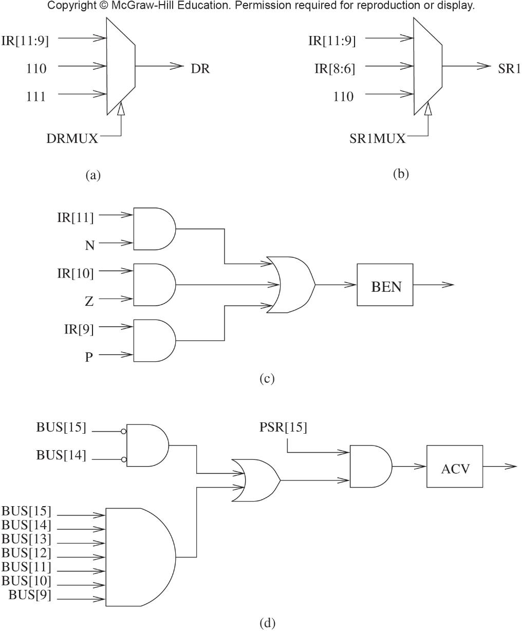
EXECUTE State for NOT
001001 ( State 9 ) 0 0 J=18
LD.REG LD.CC GateALU SR1MUX=1 ALUK=2
all other control signals are 0
NOTES:
SR1MUX=1 means use IR[8:6] as SR1
(see Fig C.6) ALUK=2 means “NOT A”

Slide 24
NOT R3, R3
(Execute)
gateMARMUX
gatePC
16
DR
3
REG
FILE
SR2 SR1
OUT OUT
MARMUX
MARMUX
LD.PC
PC
16
PCMUX
+1
16
16
2
LD.REG
PCMUX
3
16
SR2
3
3
SR1
ZEXT
Copy R3 to ALU Input A
ADDR2MUX
+
[7:0]
2
ADDR1MUX
ADDR2MUX
ADDR1MUX
16
16
16
[10:0]
SEXT
16
16
16
16
16
0
16
[4:0]
SEXT
[8:0]
SEXT
FINITE
STATE
MACHINE
SR2MUX
[5:0]
SEXT
N
Z
P
LD.CC
B
A
2
ALU
LD.IR
IR
LOGIC
R
16
16
gateALU
16
16
GateMDR
16
16
LD.MDR
MDR
MEMORY
MAR
LD.MAR
INPUT
OUTPUT
MEM.EN, R.W

Slide 25
NOT R3, R3
(Execute)
gateMARMUX
gatePC
16
DR
3
REG
FILE
SR2 SR1
OUT OUT
MARMUX
MARMUX
LD.PC
PC
16
PCMUX
+1
16
16
2
LD.REG
PCMUX
3
16
SR2
3
3
SR1
ZEXT
Copy R3 to ALU Input A
Set ALU to NOT
ADDR2MUX
+
[7:0]
2
ADDR1MUX
ADDR2MUX
ADDR1MUX
16
16
16
[10:0]
SEXT
16
16
16
16
16
0
16
[4:0]
SEXT
[8:0]
SEXT
FINITE
STATE
MACHINE
SR2MUX
[5:0]
SEXT
N
Z
P
LD.CC
B
NOT
2
A
2
ALU
LD.IR
IR
LOGIC
R
16
16
gateALU
16
16
GateMDR
16
16
LD.MDR
MDR
MEMORY
MAR
LD.MAR
INPUT
OUTPUT
MEM.EN, R.W

Slide 26
NOT R3, R3
(Execute)
gateMARMUX
gatePC
16
3
DR
3
REG
FILE
SR2 SR1
OUT OUT
MARMUX
MARMUX
LD.PC
PC
16
PCMUX
+1
16
16
2
LD.REG
PCMUX
3
16
SR2
3
3
SR1
ZEXT
Copy R3 to ALU Input A
Set ALU to NOT
Copy ALU output to R3
ADDR2MUX
+
[7:0]
2
ADDR1MUX
ADDR2MUX
ADDR1MUX
16
16
16
[10:0]
SEXT
16
16
16
16
16
0
16
[4:0]
SEXT
[8:0]
SEXT
FINITE
STATE
MACHINE
SR2MUX
[5:0]
SEXT
N
Z
P
LD.CC
B
NOT
2
A
2
ALU
LD.IR
IR
LOGIC
R
16
16
gateALU
16
16
GateMDR
16
16
LD.MDR
MDR
MEMORY
MAR
LD.MAR
INPUT
OUTPUT
MEM.EN, R.W

Slide 27
NOT R3, R3
(Execute)
gateMARMUX
gatePC
16
3
DR
3
REG
FILE
SR2 SR1
OUT OUT
MARMUX
MARMUX
LD.PC
PC
16
PCMUX
+1
16
16
2
LD.REG
PCMUX
3
16
SR2
3
3
SR1
ZEXT
Copy R3 to ALU Input A
Set ALU to NOT
Copy ALU output to R3
And copy ALU output to CC
ADDR2MUX
+
[7:0]
2
ADDR1MUX
ADDR2MUX
ADDR1MUX
16
16
16
[10:0]
SEXT
16
16
16
16
16
0
16
[4:0]
SEXT
[8:0]
SEXT
FINITE
STATE
MACHINE
SR2MUX
[5:0]
SEXT
N
Z
P
LD.CC
B
NOT
2
A
2
ALU
LD.IR
IR
LOGIC
R
16
16
gateALU
16
16
GateMDR
16
16
LD.MDR
MDR
MEMORY
MAR
LD.MAR
INPUT
OUTPUT
MEM.EN, R.W

Slide 28
Question
How many cycles does it take for the EXECUTE phase of a NOT instruction
1
Either 1 or 2
2
3
20

Slide 29
Operate (ALU) Instructions
ADD, AND
Addressing Mode?
Where do the operands come from?
Depends on bit 5
Addressing Mode
ADD
0001
DR
SR1
0
00
SR2
Register
ADD
0001
DR
SR1
1
imm5
Immediate or Literal
AND
0101
DR
SR1
0
00
SR2
Register
AND
0101
DR
SR1
1
imm5
Immediate or Literal

Slide 30
Addressing Modes (for ALU operations)
Register:
All operands come from register file
Examples:
ADD R1, R2, R3
AND R1, R2, R3
Immediate or Literal
Some operands come from bits in the instruction itself (get them from the IR, Instruction Register)
Immediate values are 5-bit two’s complement (for ADD and AND)
From bits [0:4] in the instruction itself
Sign-extend the immediate value to 16 bits two’s complement
Examples:
ADD R1, R2, #3
AND R1, R2, #-3

Slide 31
EXECUTE States for ADD & AND
ADD
000001 ( State 1 ) 0 0 J=18
LD.REG LD.CC GateALU SR1MUX=1
AND
000101 ( State 5 ) 0 0 J=18
LD.REG LD.CC GateALU SR1MUX=1 ALUK=1
NOTES:
All other control signal are 0
SR1MUX=1 means use IR[8:6] as SR1 (see Patt) SR2MUX select is IR[5]
ALUK=0 means “ADD A and B” (not shown above, default is 0)
ALUK=1 means “AND A and B”

Slide 32
Example
ADD R3,R3,R2
0001 011 011 000 010
ADD R3,R3,#2
0001 011 011 1 00010
Register
Addressing Mode
Literal or Immediate
Addressing Mode

Slide 33
ADD R3, R3, R2
(Execute)
gateMARMUX
gatePC
16
3
DR
3
REG
FILE
SR2 SR1
OUT OUT
MARMUX
MARMUX
LD.PC
PC
16
PCMUX
+1
16
16
2
LD.REG
PCMUX
3
16
2
3
3
SR1
ZEXT
SR2
Copy R3 to ALU Input A
Copy R2 to ALU input B
Set ALU to ADD
Copy ALU output to R2
And copy ALU output to CC
ADDR2MUX
+
[7:0]
2
ADDR1MUX
ADDR2MUX
ADDR1MUX
16
16
16
[10:0]
SEXT
16
16
16
16
16
0
16
[4:0]
SEXT
0
[8:0]
SEXT
FINITE
STATE
MACHINE
SR2MUX
[5:0]
SEXT
+
N
Z
P
LD.CC
0
B
A
2
ALU
LD.IR
IR
LOGIC
R
16
16
gateALU
16
16
GateMDR
16
16
LD.MDR
MDR
MEMORY
MAR
LD.MAR
INPUT
OUTPUT
MEM.EN, R.W

Slide 34
ADD R3, R3, #2
(Execute)
gateMARMUX
gatePC
16
3
DR
3
REG
FILE
SR2 SR1
OUT OUT
MARMUX
MARMUX
LD.PC
PC
16
PCMUX
+1
16
16
2
LD.REG
PCMUX
3
16
SR2
3
3
SR1
ZEXT
Copy R3 to ALU Input A
Sign-extend IR[4:0] to ALU input B
Set ALU to ADD
Copy ALU output to R3
And copy ALU output to CC
ADDR2MUX
+
[7:0]
2
ADDR1MUX
ADDR2MUX
ADDR1MUX
16
16
16
[10:0]
SEXT
16
16
16
16
16
0
16
[4:0]
SEXT
1
[8:0]
SEXT
FINITE
STATE
MACHINE
SR2MUX
[5:0]
SEXT
+
N
Z
P
LD.CC
0
B
A
2
ALU
LD.IR
IR
LOGIC
R
16
16
gateALU
16
16
GateMDR
16
16
LD.MDR
MDR
MEMORY
MAR
LD.MAR
INPUT
OUTPUT
MEM.EN, R.W

Slide 35
Data Movement Instructions
Operate (ALU)
Data Movement (Memory)
Control
ADD
AND
NOT
Load
LD
LDR
LDI
LEA
Store
ST
STR
STI
BR
JMP
JSR
JSRR
RET
RTI
TRAP

Slide 36
Data Movement Instructions
Purpose:
Load data into a register
Usually from memory
Store a register’s value out to memory

Slide 37
Addressing Modes
Where can operands (data) be found?
1. In the instruction (Literal or Immediate)
2. In registers
3. In memory
We use the term Effective Address to describe the memory location that the instruction uses for its operands.

Slide 38
Effective Address
How big is a machine instruction?
16 bits
How big is a memory address?
16 bits
Can we fit a full memory address in a machine instruction?
No, because we need some bits for the op code and other parts of the instruction.

Slide 39
Addressing Modes
Immediate or Literal
Register
PC-relative *
PC-relative is an historical term; the mode acts like PC + Offset
Base + Offset *
Indirect *
* These 3 addressing modes involve memory locations, at the effective address.
Each instruction allows a subset of these addressing modes (a common approach in a RISC architecture)

Slide 40
Addressing Modes for Data Movement
Imagine memory is a large array:
int mem[65536];
Calculate the effective address (EA), based on the addressing mode
PC relative:
mem[PC + offset]
Base + Offset:
mem[BaseReg + offset]
Indirect
mem[mem[PC + offset]]

Slide 41
Example: Calculate a PC-Relative Effective Address
We can calculate a 16-bit memory address by adding an offset value to the 16-bit PC’s (or general purpose register’s) value
For example, we can include a 9-bit offset value in the instruction itself (as two’s complement)
Can represent values from -256 to +255
Let’s call this value PCoffset9
We can add PCoffset9 to the PC value (or a register value)
We must sign-extend PCOffset9 from 9 bits to 16 bits first.
Because of the ISA design of the LC-3, we only discuss addressing modes and effective addresses for the last operand
Each operand but the last always uses Register addressing mode and the Effective Address is always the named register

Slide 42
Data Movement Instructions
Data movement instructions move
Memory to a register
A Register to memory
Examples using PC-Relative addressing
LD
0010
DR
PCoffset9
ST
0011
SR
PCoffset9
Limitations?

Slide 43
PC relative addressing mode
Address Instruction
x3000 LD R1, #6 ; PC == x3001
; will load data from memory at EA, which is x3007
; which is the value 3, and store 3 in R1
….
x3007 x0003 ; Some data, the number 3
op code DR PCoffset9
PC: x3001
+ PCoffset9: x0006 (sign-extend this from 9 to 16 bits)
Effective Address (EA): x3007
LD
0010
001
0 0000 0110

Slide 44
Basic Format
Op
DR or SR
Address generation bits
These encode information on
how to form a 16 bit address
or a register address.
You’ll see this described as
“OP2” in the LC-3 diagrams.

Slide 45
LD Example
Addr Content Tag Op Operands
.orig x3000
3000 0015 .fill 21 3001 27FE LD R3, #-2
0010 011 1 1111 1110 LD R3 -2
What happens when we execute at x3001?

Slide 46
Load from Memory: 3+ cycles
Send the address to MAR
Read memory[MAR] into MDR
Send MDR back to a register
Recall FETCH (get a machine code instruction from memory)
Load (LD) is similar – but its execution state gets data from memory into a register

Slide 47
LD R3,-2
(Execute state 1)
gateMARMUX
gatePC
16
DR
3
REG
FILE
SR2 SR1
OUT OUT
MARMUX
MARMUX
LD.PC
PC
16
PCMUX
+1
16
16
2
LD.REG
PCMUX
16
SR2
3
3
SR1
ZEXT
Add SEXT(IR[8:0]) to the (incremented) PC and store in MAR
ADDR2MUX
+
[7:0]
2
1
ADDR1MUX
ADDR2MUX
ADDR1MUX
16
16
16
[10:0]
SEXT
16
16
16
16
16
0
16
[4:0]
SEXT
[8:0]
SEXT
FINITE
STATE
MACHINE
SR2MUX
[5:0]
SEXT
N
Z
P
LD.CC
B
A
2
ALU
LD.IR
IR
LOGIC
R
0x27FE
gateALU
16
16
16
16
GateMDR
16
16
LD.MDR
MDR
MEMORY
MAR
LD.MAR
INPUT
OUTPUT
MEM.EN, R.W

Slide 48
LD R3,-2
(Execute state 1)
gateMARMUX
gatePC
16
1
3
MARMUX
LD.PC
PC
DR
REG
FILE
SR2 SR1
OUT OUT
MARMUX
16
PCMUX
+1
16
16
2
LD.REG
PCMUX
16
SR2
3
3
SR1
ZEXT
Add SEXT(IR[8:0]) to the (incremented) PC and store in MAR
ADDR2MUX
+
[7:0]
2
1
1
ADDR1MUX
ADDR2MUX
ADDR1MUX
16
16
16
[10:0]
SEXT
16
16
16
16
16
0
16
[4:0]
SEXT
[8:0]
SEXT
FINITE
STATE
MACHINE
SR2MUX
[5:0]
SEXT
N
Z
P
LD.CC
B
A
2
ALU
LD.IR
IR
LOGIC
R
0x27FE
gateALU
16
16
16
16
GateMDR
16
16
LD.MDR
MDR
MEMORY
MAR
LD.MAR
INPUT
OUTPUT
MEM.EN, R.W

Slide 49
LD R3,-2
(Execute state 1)
gateMARMUX
gatePC
16
1
3
MARMUX
LD.PC
PC
DR
REG
FILE
SR2 SR1
OUT OUT
MARMUX
16
PCMUX
+1
16
16
2
LD.REG
PCMUX
16
SR2
3
3
SR1
ZEXT
Add SEXT(IR[8:0]) to the (incremented) PC and store in MAR
ADDR2MUX
+
[7:0]
2
1
1
ADDR1MUX
ADDR2MUX
ADDR1MUX
16
16
16
[10:0]
SEXT
16
16
16
16
16
0
16
[4:0]
SEXT
[8:0]
SEXT
FINITE
STATE
MACHINE
SR2MUX
[5:0]
SEXT
N
Z
P
LD.CC
B
A
2
ALU
LD.IR
IR
LOGIC
R
0x27FE
gateALU
16
16
16
16
GateMDR
16
16
LD.MDR
MDR
MEMORY
MAR
LD.MAR
INPUT
OUTPUT
MEM.EN, R.W

Slide 50
LD R3,-2
(Execute state 2)
gateMARMUX
gatePC
16
DR
3
REG
FILE
SR2 SR1
OUT OUT
MARMUX
MARMUX
LD.PC
PC
16
PCMUX
+1
16
16
2
LD.REG
PCMUX
16
SR2
3
3
SR1
ZEXT
Add SEXT(IR[8:0]) to the (incremented) PC and store in MAR
Raise MEM.EN and LD.MDR to cause a memory fetch from mem[MAR] into MDR
ADDR2MUX
+
[7:0]
2
ADDR1MUX
ADDR2MUX
ADDR1MUX
16
16
16
[10:0]
SEXT
16
16
16
16
16
0
16
[4:0]
SEXT
[8:0]
SEXT
FINITE
STATE
MACHINE
SR2MUX
[5:0]
SEXT
N
Z
P
LD.CC
B
A
2
ALU
LD.IR
IR
LOGIC
R
0x27FE
gateALU
16
16
16
16
GateMDR
16
16
LD.MDR
MDR
MEMORY
MAR
LD.MAR
INPUT
OUTPUT
MEM.EN, R.W

Slide 51
LD R3,-2
(Execute state 3)
gateMARMUX
gatePC
16
3
3
REG
FILE
SR2 SR1
OUT OUT
MARMUX
MARMUX
LD.PC
PC
DR
16
PCMUX
+1
16
16
2
LD.REG
PCMUX
16
SR2
3
3
SR1
ZEXT
Add SEXT(IR[8:0]) to the (incremented) PC and store in MAR
Raise MEM.EN and LD.MDR to cause a memory fetch from mem[MAR] into MDR
Copy the value in MDR into R3, setting the condition codes
ADDR2MUX
+
[7:0]
2
ADDR1MUX
ADDR2MUX
ADDR1MUX
16
16
16
[10:0]
SEXT
16
16
16
16
16
0
16
[4:0]
SEXT
[8:0]
SEXT
FINITE
STATE
MACHINE
SR2MUX
[5:0]
SEXT
N
Z
P
LD.CC
B
A
2
ALU
LD.IR
IR
LOGIC
R
0x27FE
gateALU
16
16
16
16
GateMDR
16
16
LD.MDR
MDR
MEMORY
MAR
LD.MAR
INPUT
OUTPUT
MEM.EN, R.W

Slide 52
LD R3,-2
(Signals)
gateMARMUX
gatePC
16
1
3
3
REG
FILE
SR2 SR1
OUT OUT
MARMUX
MARMUX
LD.PC
PC
DR
16
PCMUX
+1
16
16
2
LD.REG
PCMUX
16
SR2
3
3
SR1
ZEXT
ADDR2MUX=1 ADDR1MUX=1 MARMUX=1 gateMARMUX LD.MAR
MEM.EN LD.MDR
gateMDR DR=IR[11:9] LD.REG LD.CC
ADDR2MUX
+
[7:0]
2
1
1
ADDR1MUX
ADDR2MUX
ADDR1MUX
16
16
16
[10:0]
SEXT
16
16
16
16
16
0
16
[4:0]
SEXT
[8:0]
SEXT
FINITE
STATE
MACHINE
SR2MUX
[5:0]
SEXT
N
Z
P
LD.CC
B
A
2
ALU
LD.IR
IR
LOGIC
R
0x27FE
gateALU
16
16
16
16
GateMDR
16
16
LD.MDR
MDR
MEMORY
MAR
LD.MAR
INPUT
OUTPUT
MEM.EN, R.W

Slide 53
Data Movement Instructions
Base + Offset
LDR+
0110
DR
BaseR
offset6
STR
0111
SR
BaseR
offset6

Slide 54
Data Movement Instructions
Indirect Mode
LDI+
1010
DR
PCoffset9
STI
1011
SR
PCoffset9

Slide 55
Data Movement Instructions
Immediate Mode
LEA
1110
DR
PCoffset9
No memory access!

Slide 56
Where’s the Operand?
Addressing Mode | Operand
Immediate | SEXT(IR[4:0])
Register | Use the contents of the specified register
PC-relative | Compute PC + SEXT(IR[8:0]) or SEXT(IR[10:0]) and dereference -- remember that PC is already incremented by this time in the instruction cycle
Base + Offset | Compute specified register + SEXT(IR[5:0]) and dereference
Indirect | Compute PC-relative address as above in PC-relative, but dereference* twice
* Dereference : Interpret what you have as a memory address and fetch

Slide 57
Which instructions use the Base + Offset addressing mode?
LDR, STR
JMP
BRP
LDI, STI
Today’s number is 70,912
30

Slide 58
Compare and Contrast
LEA DR←PC + PCOffset9
LD DR←Mem[PC + PCOffset9]
LDI DR←Mem[Mem[PC + PCOffset9]]
LDR DR←Mem[BaseR + Offset6]

Slide 59
Loads
LEA: Puts the effective address (PC+offset) itself into a register (no memory access!)
LD: Puts the contents of some memory at the effective address (PC+offset) into a register
LDR: Puts the contents of the effective address (base register+offset) into a register.
LDI: Goes to the effective address (PC+offset) and gets a value. Treats that value as another memory address, and gets data from there, into a register (hits memory twice)

Slide 60
Store to Memory: 3+ cycles
Send the address to MAR
Send the data to MDR
Store MDR into memory[MAR]
NOTE: Indirect addressing mode takes 5 cycles
STI (store indirect)
LDI (load indirect) also takes 5 cycles

Slide 61
Stores
ST: Puts the contents of a register into memory at the effective address (PC+offset).
STR: Puts the contents of a register into memory at the effective address (base register+offset)
STI: Puts the contents of a register into a memory location whose address is stored in memory at the effective address (PC+offset). (Hits memory twice!)

Slide 62
A word of advice
Probably the most confusing thing for the new assembly language programmer is the confusion between memory addresses and memory contents
Consider int x = 10; x = x + 2;
What exactly do we mean by x?
x is a name given to a memory address, but it means something different depending on which side of the assignment it appears
On the left, it is a place in which to store the assigned value; on the right it means “the value stored at memory address x”
Programming languages do this implicit dereferencing of the right side variables for you; assembly language does not!

Slide 63
LD Example
Value
Reg
x0000
R0
x1000
R1
LD
0010
DR
PCoffset9
x2000
R2
x3000
R3
x4000
R4
PC->
x3000: 0010 010 000000111
x3008: 0000 0000 0000 0001
EA=x3001+x7
x5000
R5
EA=x3008
x6000
R6
x7000
R7

Slide 64
Example
Value
Reg
x0000
R0
x1000
R1
LD
0010
DR
PCoffset9
x0001
R2
x3000
R3
x4000
R4
PC->
x3000: 0010 010 000000111
x3008: 0000 0000 0000 0001
EA=x3001+x7
x5000
R5
EA=x3008
x6000
R6
x7000
R7

Slide 65
LDI Example
Value
Reg
x0000
R0
x1000
R1
LDI
1010
DR
PCoffset9
x2000
R2
x3000
R3
x4000
R4
x5000
R5
PC->
x3000: 1010 011 000000111
x3008: 0011 0000 0001 0000
x3010: 0000 0000 0010 1010
EA=M[x3001+x7]
x6000
R6
EA=M[x3008]
x7000
R7
EA=x3010

Slide 66
LDI Example
Value
Reg
x0000
R0
x1000
R1
LDI
1010
DR
PCoffset9
x2000
R2
x002a
R3
x4000
R4
x5000
R5
PC->
x3000: 1010 011 000000111
x3008: 0011 0000 0001 0000
x3010: 0000 0000 0010 1010
EA=M[x3001+x7]
x6000
R6
EA=M[x3008]
x7000
R7
EA=x3010

Slide 67
STR Example
Value
Reg
x0000
R0
x1000
R1
STR
0111
SR
BaseR
offset6
x2000
R2
x3010
R3
x4000
R4
PC->
x3000: 0111 110 011 000011
x3010: 0000 0000 0010 1010
x3011: 0000 0000 0000 0000
x3012: 0000 0000 0000 1111
x3013: 0000 0000 1111 0000
EA=X3010+x3
x5000
R5
EA=X3013
x6000
R6
x7000
R7

Slide 68
STR Example
Value
Reg
x0000
R0
x1000
R1
STR
0111
SR
BaseR
offset6
x2000
R2
x3010
R3
x4000
R4
PC->
x3000: 0111 110 011 000011
x3010: 0000 0000 0010 1010
x3011: 0000 0000 0000 0000
x3012: 0000 0000 0000 1111
x3013:
EA=X3010+x3
x5000
R5
EA=X3013
x6000
R6
x7000
R7
x3013: 0110 0000 0000 0000

Slide 69
LEA Example
Value
Reg
x0000
R0
x1000
R1
x2000
R2
LEA
1110
DR
PCoffset9
x3000
R3
x4000
R4
PC->
x3000: 1110 011 0 0000 1111
x3010: 0000 0000 0010 1010
x3011: 0000 0000 0000 0000
x3012: 0000 0000 0000 1111
x3013: 0000 0000 1111 0000
EA=x3001+xF
x5000
R5
EA=x3010
x6000
R6
x7000
R7

Slide 70
LEA Example
Value
Reg
x0000
R0
x1000
R1
x2000
R2
LEA
1110
DR
PCoffset9
x3010
R3
x4000
R4
PC->
x3000: 1110 011 0 0000 1111
x3010: 0000 0000 0010 1010
x3011: 0000 0000 0000 0000
x3012: 0000 0000 0000 1111
x3013: 0000 0000 1111 0000
EA=x3001+xF
x5000
R5
EA=x3010
x6000
R6
x7000
R7

Slide 71
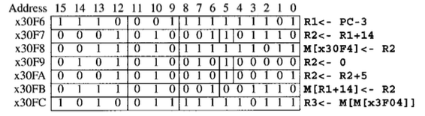
Example – Assembly Code Tracing
Opcodes
ADD 0x1
LEA 0xE
ST 0x3
AND 0x5
STR 0x7
LDI 0xA
LEA R1,#-3
ADD R2,R1,#14
ST R2,#-5
AND R2,R2,#0
ADD R2,R2,#5
STR R2,R1,14
LDI R3,#-9
R1 R2 R3 x30f4 x3102
x30f4 - - - -
x3102
x3102
0
5
5
5

Slide 72
Control Instructions
Operate (ALU)
Data Movement (Memory)
Control
ADD
AND
NOT
Load
LD
LDR
LDI
LEA
Store
ST
STR
STI
BR
JMP
JSR
JSRR
RET
RTI
TRAP

Slide 73
Question
If you don’t want program execution to proceed to the next instruction in sequence, what register must be changed?
Instruction Register (IR)
Memory Address Register (MAR)
Memory Data Register (MDR)
Program Counter (PC)
40

Slide 74
Changing the Sequence of Instructions
In the FETCH phase, we increment the Program Counter by 1.
What if we don’t want to execute the instruction that follows this one?
examples: loop, if-then, function call
We need special instructions that change the contents of the PC.
These are called control instructions.
jumps are unconditional -- they always change the PC
branches are conditional -- they change the PC only if some condition is true (e.g., the result of an ADD is zero)

Slide 75
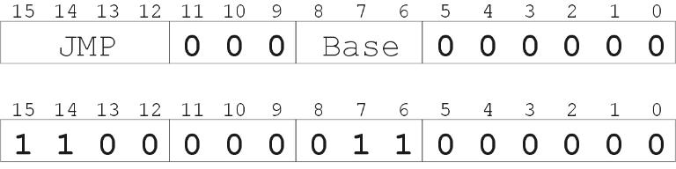
Example: LC-3 JMP Instruction
Set the PC to the value contained in a register. This becomes the address of the next instruction to fetch.
“Move the contents of R3 into the PC.”

Slide 76
JMP R3
(Execute state)
gateMARMUX
gatePC
16
DR
3
REG
FILE
SR2 SR1
OUT OUT
MARMUX
MARMUX
LD.PC
PC
16
PCMUX
+1
16
16
1
2
LD.REG
PCMUX
16
3
3
3
ZEXT
SR2
SR1
Copy R3 through ALU, bus, and PCMUX to PC
SR1=IR[8:6]
SR1MUX=1
ALUK=3 (PASS A)
gateALU
PCMUX=1
LD.PC
ADDR2MUX
+
[7:0]
2
ADDR1MUX
ADDR2MUX
ADDR1MUX
16
16
16
[10:0]
SEXT
16
16
16
16
16
0
16
[4:0]
SEXT
[8:0]
SEXT
FINITE
STATE
MACHINE
SR2MUX
[5:0]
SEXT
N
Z
P
LD.CC
3
B
A
2
ALU
LD.IR
IR
LOGIC
R
0xC060
gateALU
16
16
16
16
GateMDR
16
16
LD.MDR
MDR
MEMORY
MAR
LD.MAR
INPUT
OUTPUT
MEM.EN, R.W

Slide 77
LC-3 FSM State Diagram (Patt 2ed)

Slide 78
FSM States for Executing JMP

Slide 79
EXECUTE State for JMP
001100 ( State 12 ) 0 0 J=18 LD.PC GateALU PCMUX=1 SR1MUX=1 ALUK=3
all other control signals are 0
NOTES:
SR1MUX=1 means use IR[8:6] as SR1 ALUK=3 means “Pass A”

Slide 80
LC-3 Instructions, first half
ADD⁺
0001
DR
SR1
0
00
SR2
ADD⁺
0001
DR
SR1
1
imm5
AND⁺
0101
DR
SR1
0
00
SR2
AND⁺
0101
DR
SR1
1
imm5
BR
0000
n
z
p
PCoffset9
JMP
1100
000
BaseR
000000
JSR
0100
1
PCoffset11
JSRR
0100
0
00
BaseR
000000
LD⁺
0010
DR
PCoffset9
LDI⁺
1010
DR
PCoffset9
⁺ Indicates instructions that modify condition codes

Slide 81
LC-3 Instructions, second half
LDR⁺
0110
DR
BaseR
offset6
LEA
1110
DR
PCoffset9
NOT⁺
1001
DR
SR
111111
RET
1100
000
111
000000
RTI
1000
000000000000
ST
0011
SR
PCoffset9
STI
1011
SR
PCoffset9
STR
0111
SR
BaseR
offset6
TRAP
1111
0000
trapvect8
reserved
1101
⁺ Indicates instructions that modify condition codes

Slide 82



Control Instructions
JMP
1100
000
BaseR
000000
register
Set PC to contents of BaseR
BR
0000
n
z
p
PCoffset9
PC relative
Add offset to PC if condition matches
JSR
0100
1
PCoffset11
PC relative
JSRR
0100
0
00
BaseR
000000
register
Save PC in R7, then add PCoffset11 or set to BaseR
RET
1100
000
111
000000
register
Set PC to contents of R7 (a.k.a. JMP R7)

Slide 83
Condition Codes
N - Negative
Z - Zero
P - Positive
When is the condition code register set?
During EXECUTE when LD.CC is high
Only set by ADD, AND, NOT, LD, LDR, LDI
Otherwise the CCs remain unchanged
How are they used?
There are 3 bits in the BR instruction that are ANDed with the NZP condition code bits. If any bits are on, the branch is taken; otherwise the instruction in the following word is fetched next

Slide 84
Branch Logic
gateMARMUX
gatePC
16
DR
3
REG
FILE
SR2 SR1
OUT OUT
MARMUX
MARMUX
LD.PC
PC
16
PCMUX
+1
16
16
2
LD.REG
PCMUX
16
SR2
3
3
SR1
ZEXT
ADDR2MUX
+
[7:0]
2
ADDR1MUX
ADDR2MUX
ADDR1MUX
16
16
16
[10:0]
SEXT
16
16
16
16
16
0
16
[4:0]
SEXT
[8:0]
SEXT
FINITE
STATE
MACHINE
SR2MUX
[5:0]
SEXT
N
Z
P
LD.CC
B
A
2
ALU
LD.IR
IR
LOGIC
R
16
16
gateALU
16
16
GateMDR
16
16
LD.MDR
MDR
MEMORY
MAR
LD.MAR
INPUT
OUTPUT
MEM.EN, R.W

Slide 85
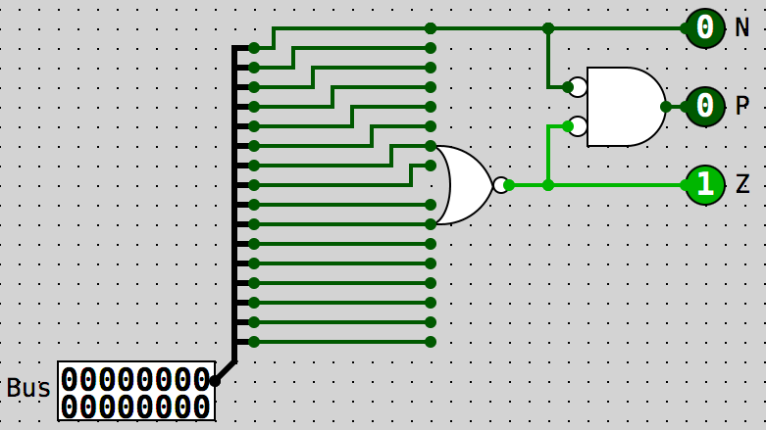
Condition Code Logic

Slide 86
Which instructions set Condition Codes?
All the ALU instructions
ADD, AND, NOT
the LOAD (data movement) instructions
LD, LDR, LDI
In other words, every instruction that changes the value of a general purpose register, R0-R7
Except for LEA
All other instructions do NOT change the condition code.

Slide 87
Which of these groups of instructions all set the condition codes (NZP)?
LEA, LD, LDR
ST, STR, STI
JMP, JSRR, RET
LD, LDR, ADD, NOT
50

Slide 88
Questions?

Slide 89
What registers are transferred during the EXECUTE phase of JMP R3
?
PC <- R7
R7 <- PC
PC <- R3
R7 <- PC PC <- R3
60

Slide 90
DECODE, in the datapath
Recall, every instruction starts with these four states:
Fetch
Fetch
Fetch
Decode
How does DECODE work?
This is where the state machine is implemented in the LC-3

Slide 91
How Does that Control Unit (FSM) Work?
The control unit controls the flow of data in the LC-3 data path
Rather than have a big sequential logic circuit, the Control Unit executes a built-in program which is called microcode
Each cycle through the microcode (program) executes one LC-3 machine instruction
The microcode itself runs on a smaller sequential logic circuit to carefully choose a sequence from 64 possible states
The components of the control unit are
The Control Store
The Microsequencer

Slide 92
Recall LC-3 State Machine
The FSM, which sequences through the states.
It turns on the appropriate control signals as it enters each state.
F
18
EA/OP/EX/S
1
D
6
33
32
35
12
A more complete state diagram is in Appendix C.
It will be more understandable after the rest of this deck

Slide 93
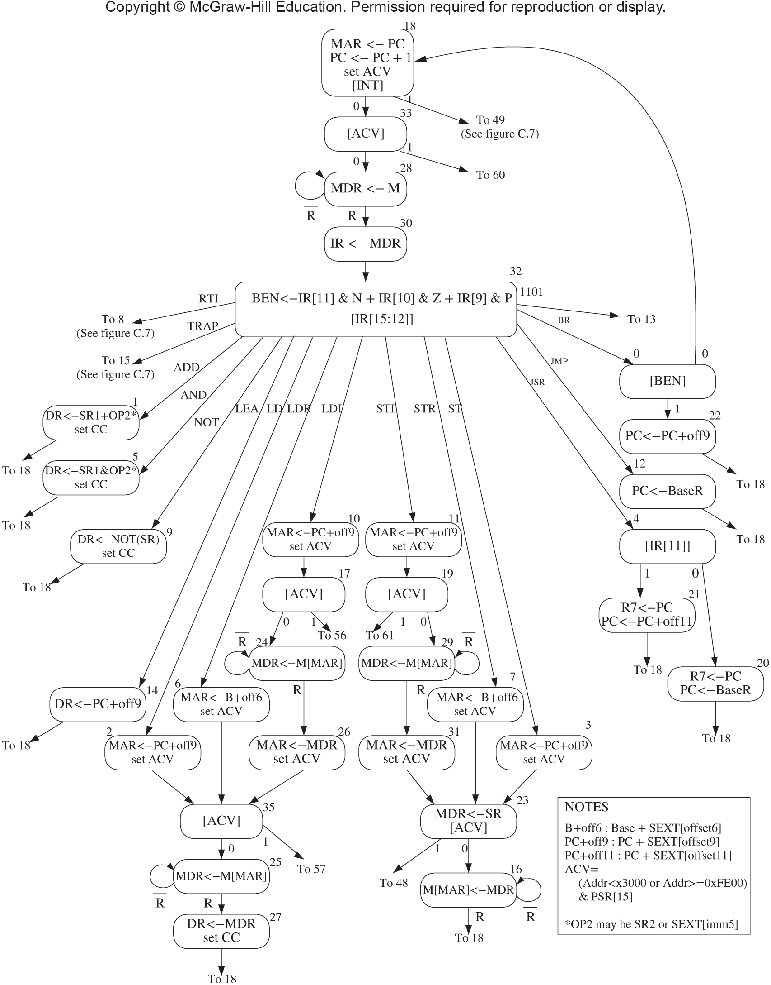
LC-3 as a Finite State Machine (see Patt Fig C.2 3rd ed.)

Slide 94
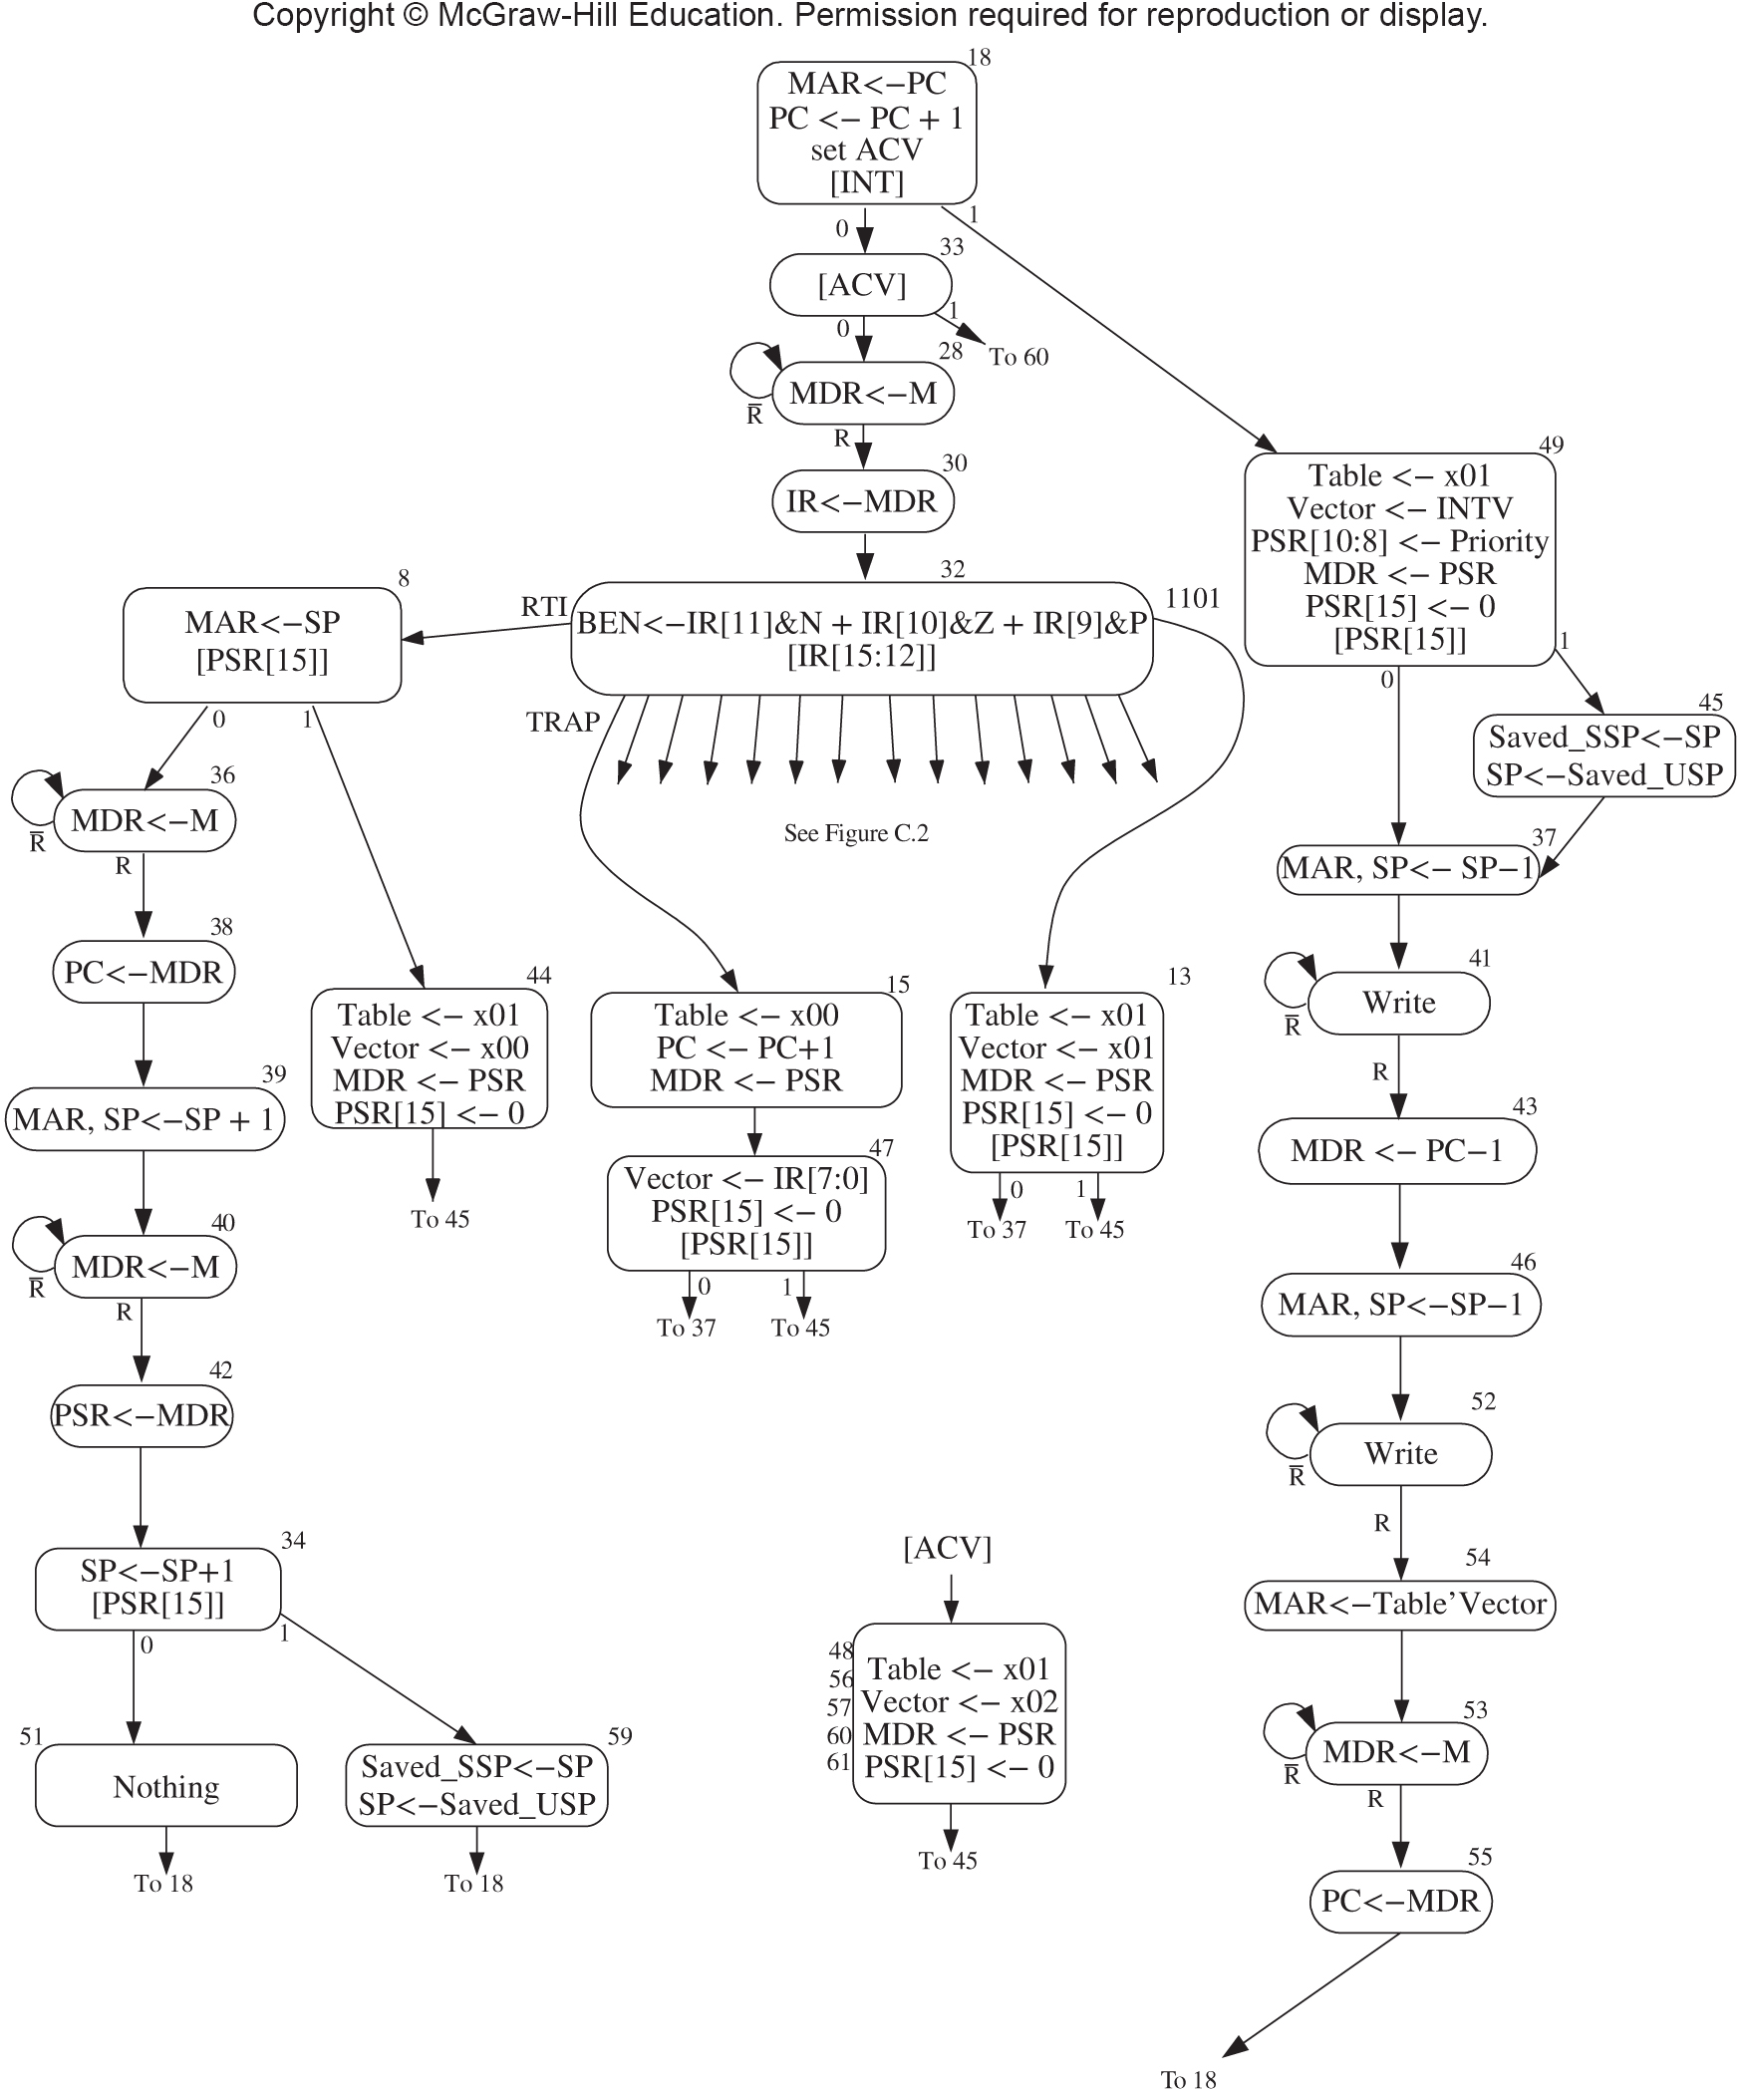
The Rest of the FSM; Patt Fig C.7 Exception, Interrupts, Traps
This is the rest of the FSM diagram.
The only thing you might need are the TRAP and RTI states

Slide 95
Sequential Logic Circuit (FSM)
Combinational
Logic Circuit
Storage
Elements

Slide 96
Question
We are given the diagram for a reasonably complex Finite State Machine. What is the best thing to do next in order to construct it?
Build a K-map
Build a truth table
Build a set of Boolean equations
Assemble a circuit
70

Slide 97
LC-3 FSM (Controller)
How shall we implement this monster?
Shall we start with a truth table?
We have a state diagram with <= 64 states (hence the 6-bit Next State)
How big will this truth table be?
10+6 Inputs means 2¹⁶ rows
Input
10 signals
Combinational
Logic Circuit
Output
42 signals
Current State
6 signals
Storage
Elements
Next State
6 signals

Slide 98
This Would Be Our Truth Table
Current
state
6
Next
state
6
Inputs
10
Outputs
42
65536
rows
. . .

Slide 99
What Next?
Who volunteers to do the 48 8-dimensional 16-variable Karnaugh maps?
Does this make you think our standard procedure for turning a truth table into an FSM is going to scale well?
Do you think we could store our truth table in a read-only memory (ROM)?
If we sort the rows in numerical order by the 16 Input bits, the Input bits would be the same as the memory address for that row
Then we could look up our Output values and Next State with a single memory access! And we could just hook up our Output lines and Next State to the output from the memory!
Wouldn’t have to calculate and implement all that combinational logic!
By the way, we wouldn’t have to store the first 16 bits since it matches the address and we only use the Inputs to choose the row with the appropriate Outputs

Slide 100
Using a ROM for Our Truth Table
Current
state
6
Next
state
6
Inputs
10
Outputs
42
65536
rows
. . .
This is the row address
396,216 bytes – but the LC-3 is just a minimal ISA!

Slide 101
What Next?
That seems like a lot of memory for a small ISA; how is that going to scale?
Another scaling problem, right?
Recall that in the truth table, the Outputs (not including the Next State) are the same for all rows with the same Current State (because our Outputs are associated with a state, not the transition)
What if we could compute the Next State in a different way? Then we’d only need one row of outputs for each FSM state! 64 rows instead of 65536!

Slide 102
Now We Need to Compute Next State From the Inputs
Current
state
6
Info to compute next state
?
Outputs
42
64
entries
. . .
This is the row address

Slide 103
A Work-Around
Let’s use 6 bits in each row for Next State (because most of the time there’s only one state that can follow our state)?
We’ll call this value J[0:5]
Here’s an example; doesn’t the state diagram look mostly like this?
State 12
State 29
State 21
State 42
J=29
J=21
J=42

Slide 104
What If More than One State Can Follow Our State?
First we’ll agree to allow only 2 states to follow a state, at least most of the time (we can always add another state to choose between two more states)
Then we add 4 more bits to each row into which we code the decisions when a state can be followed by one of two states
We’ll call those values IRD[0] and COND[0:2]
If they’re both zero, we’ll just use the value of J for Next State
State 10
State 28
State 32
State 50
J=28
J=32
J=50
J=10
State 30
State 36
J=10
J=10

Slide 105
What Would our Control Store Look Like?
Current
state
6
COND, IRD
3+1
Next
State (J)
6
Outputs
42
64
entries
. . .
This is the row address
416 bytes

Slide 106
The Four “Magic” Bits for Choosing Next State
We are going to use the COND and IRD bits to help us choose a different next state from the one listed by J
If the IRD bit is true, we are going to use the opcode in IR[15:12] as the Next State, ignoring J completely
COND allows us to choose one of six conditions to be tested
When the condition is true, the indicated bit in J is set to 1
That means in a state with COND set to something other than 000, there are exactly two possible next states:
J
J with one specific bit set to 1
000 | Unconditional |  | 100 | Privilege mode | J[3]
001 | Memory Ready | J[1] | 101 | Interrupt present | J[4]
010 | Branch Enabled | J[2] | 110 | Access Control Violation | J[5]
011 | Addressing Mode | J[0] | 111 | Not Used

Slide 107
Microsequencer
We use the term microsequencer for the combinational circuit that chooses the next state from the 10 input lines and the current state
For example, if the J=28 (011100) and COND=001, then if the memory is ready, the next state will be 30; otherwise it will be 28.
If the J=18 (010010) and COND=010, then if the BEN register is true meaning the current machine instruction should branch, the next state will be 22; otherwise it will be 18
See how simple that is. Each condition, when tested and true, sets a single bit in J to 1.
Also note that the FSM is running a program described by the state diagram, but there is no Program Counter; each state must always specify the Next State – there is no implicit “next” state

Slide 108
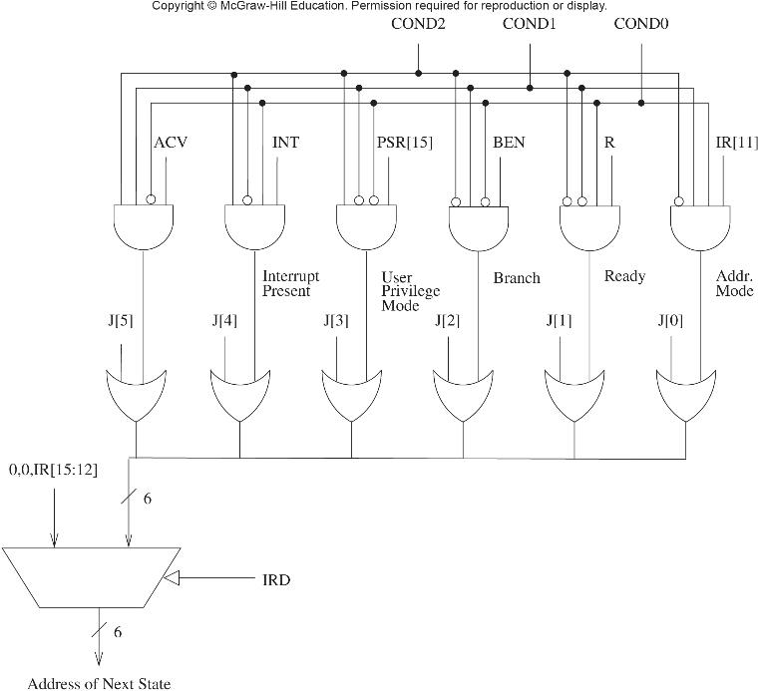
The Microsequencer Patt Fig C.6

Slide 109
The Control Structure
42 bits
Control
Output
10 inputs
6
Combinational
Logic
Control Store
(Memory)
2⁶ X 52 bits
42 (bits 10-52)
Control Signals (e.g. LD.PC, LD.CC, ALUK, GATE.ALU)
10 (IRD, COND[0:2], J[0:5])
INT
Microsequencer
R
IR[15:12], IR[11]
6 bits
State
BEN
PSR[15]
(See diagram on a subsequent slide)
ACV
6 (next state)
Six-bit register
(Think “MAR for the Control Store”)

Slide 110
Question
In the LC-3 microsequencer, for a given Current State, how many possibilities are there for the Next State?
1
1 or 2
1, 2, or 3
1, 2, or 16
TODAYS number: 22,521
80

Slide 111
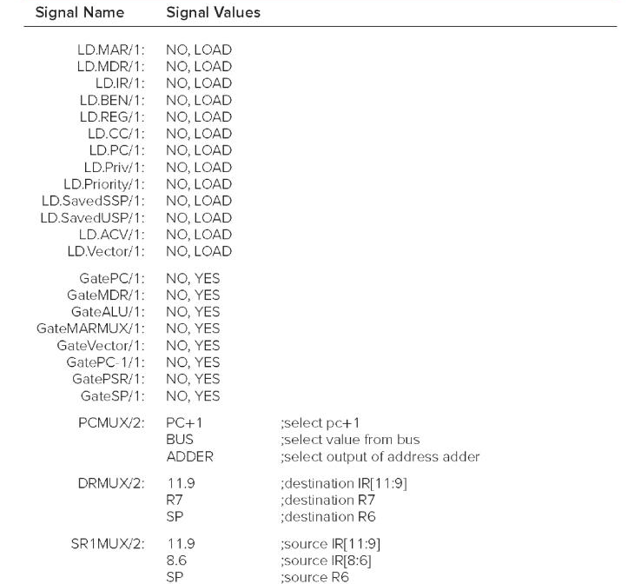
Data Path Control Signals Patt Table C.1

Slide 112

Data Path Control Signals (cont) Patt Table C.1

Slide 113
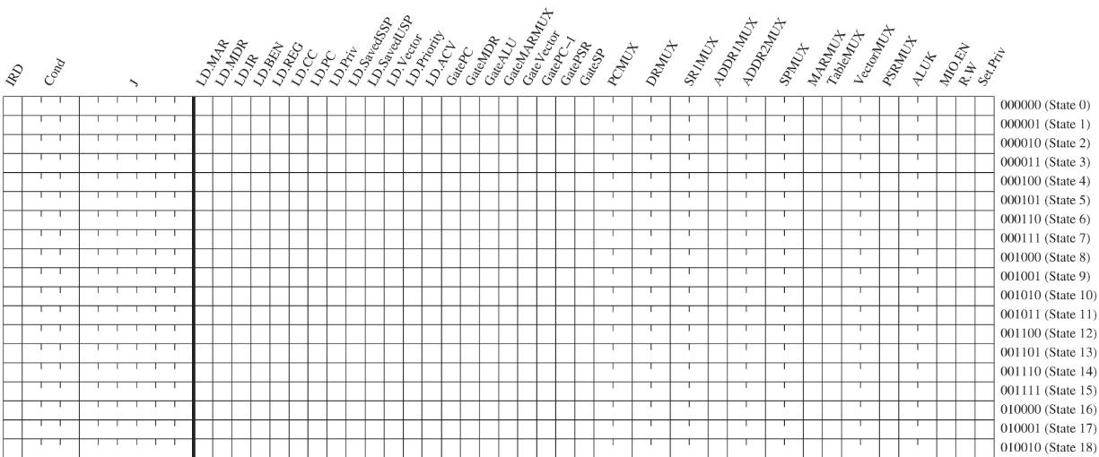
Contents of the Control Store

Slide 114
First 16 States of LC-3 Microcode
State | Next State | Control Signals (non-zero)
000000 ( State 0 ) | COND=2 J=18
000001 ( State 1 ) | J=18 | LD.REG LD.CC GateALU SR1MUX=1
000010 ( State 2 ) | J=35 | LD.MAR LD.ACV GateMARMUX ADDR2MUX=1 ADDR2MUX=2 MARMUX=1
000011 ( State 3 ) | J=23 | LD.MAR LD.ACV GateMARMUX ADDR2MUX=1 ADDR2MUX=2 MARMUX=1
000100 ( State 4 ) | COND=3 J=20
000101 ( State 5 ) | J=18 | LD.REG LD.CC GateALU SR1MUX=1 ALUK=1
000110 ( State 6 ) | J=35 | LD.MAR LD.ACV GateMARMUX ADDR1MUX=1 ADDR2MUX=2 ADDR2MUX=1 MARMUX=1
000111 ( State 7 ) | J=23 | LD.MAR LD.ACV GateMARMUX ADDR1MUX=1 ADDR2MUX=2 ADDR2MUX=1 MARMUX=1
001000 ( State 8 ) | COND=4 J=36 | LD.MAR GateALU SR1MUX=2 ALUK=3
001001 ( State 9 ) | J=18 | LD.REG LD.CC GateALU SR1MUX=1 ALUK=2
001010 ( State 10 ) | J=17 | LD.MAR LD.ACV GateMARMUX ADDR2MUX=1 ADDR2MUX=2 MARMUX=1
001011 ( State 11 ) | J=19 | LD.MAR LD.ACV GateMARMUX ADDR2MUX=1 ADDR2MUX=2 MARMUX=1
001100 ( State 12 ) | J=18 | LD.PC GateALU PCMUX=1 SR1MUX=1 ALUK=3
001101 ( State 13 ) | COND=4 J=37 | LD.MDR LD.Priv LD.Vector GatePSR TableMUX=1 VectorMUX=2
001110 ( State 14 ) | J=18 | LD.REG GateMARMUX ADDR2MUX=1 ADDR2MUX=2 MARMUX=1
001111 ( State 15 ) | J=47 | LD.MDR LD.PC LD.Vector GatePSR
You can find this information in figureC9v3.xls

Slide 115
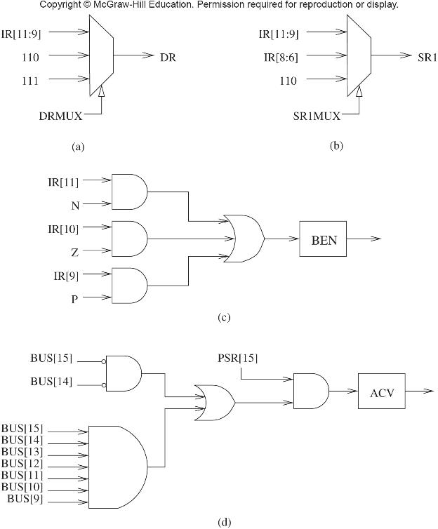
Omissions From the Data Path Diagram
Branch ENabled (BEN)
Register storing the answer to ”Should we branch”
ACcess Violation (ACV)
Register storing the answer to “Is the CPU in user state (PSR[15]) and (address on the bus < 0x3000 or >=0xFE00)”

Slide 116
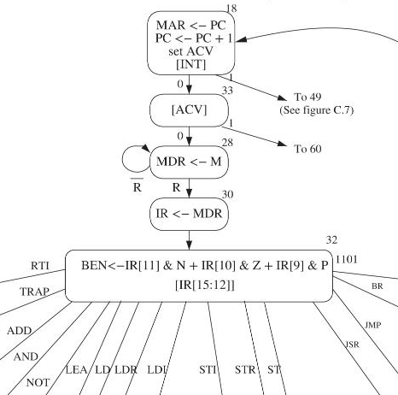
Fetch Stage Example
State 18 starts the fetch
MAR <- PC
PC <- PC + 1
Test PC value for Access Violation (out of bounds)
COND5 and J=33 (if interrupt go to 33+16=49 else 33)
State 33 checks for an access violation
COND6 and J=28 (if ACV go to 28+32=60 else 28)
State 28 waits for read complete
Assert MEM.EN
MDR <- MEM[MAR]
COND1 and J=28 (if R go to state 28+2=30 else 28)
State 30 moves the instruction to IR
IR <- MDR
COND0 and J=32 so next state is 32

Slide 117
Fetch Stage Microcode
State | IRD | CONDx
( State 18 ) | 0 | 5 | J=33 | LD.MAR | LD.PC | GatePC | LD.ACV
( State 33 ) | 0 | 6 | J=28
( State 28 ) | 0 | 1 | J=30 | LD.MDR | MEM.EN
( State 30 ) | 0 | 0 | J=32 | LD.IR | GateMDR
The Next State is a possibly modified version of J
COND6 says “Set bit 5 (+32) in J if ACV is true
COND5 says “Set bit 4 (+16) in J if an interrupt is waiting”
COND1 says “Set bit 1 (+2) in J if memory is Ready
COND0 says “Use unmodified J”
You can find this information in figureC9v3.xls

Slide 118
Branch Example
State 32 does the decode
BEN <- IR[11] & N | IR[10] & Z | IR[9] & P
State 32 has IRD=1 for next state
State 0 is chosen for a BRx instruction
State 0 has J=18 and COND2 for next state
The next state will be 18 if BEN is 0 or 22 (18 + 4) if BEN is 1
State 22 changes the PC
PC <- PC + off9
State has J=18 and COND0
So next state is 18
State 18 starts the fetch cycle again

Slide 119
Decode/Execute Microcode for BR
State | IRD | CONDx
( State 32 ) | 1 | 0 | J=0 | LD.BEN
( State 0 ) | 0 | 2 | J=18
( State 22 ) | 0 | 0 | J=18 | LD.PC | GateMARMUX | PCMUX=2 | ADDR2MUX=2
IRD=1 says use IR[15:12] as the Next State COND2 says “Set bit 2 (+4) in J if BEN is set”
FYI, there is a single-bit BEN flip-flop with write-enable signal LD.BEN; this register is where the calculation of BEN is stored
You can find this information in figurec9v2.xls

Slide 120
Microcode?
Note that the state diagram shows the register transfers done in each word/state in the microcode! In other words, this is the microcode in a readable form! Fig C.3

Slide 121
Questions?

Slide 122
Which Do You Think Came First?
(a) The data path diagram
(b) The FSM graph
(c) The microcode
(d) The instruction set
Why?

Slide 123
Questions?
The ISA: Overview
Memory, Registers, Instruction Set, Opcodes, Datatypes, Addressing Modes, Condition Codes
Instruction Set
Datapath, Control signals to implement each instruction
ALU, Data movement (load/store), and Control Instructions
Addressing Modes
The Microsequencer and Microcode

